Slide 1

Hildenborough Project Update​

Slide 2
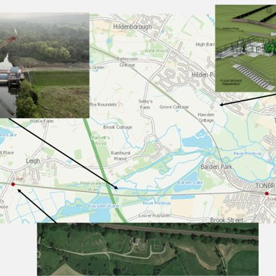


Project Overview
The scope of works for the Leigh Scheme include:​
Procurement & installation of a new gearbox winch system to lift the gates.​
Fabrications & installation of three new gates ​
Design & Installation of new electrical systems & MCCs.​
Fabrication & installation of a new Eel Pass.​
Raising of embankments at the nearby Leigh Pumping Station​
Installation of a brand new pumping station at Hildenborough​

Slide 3
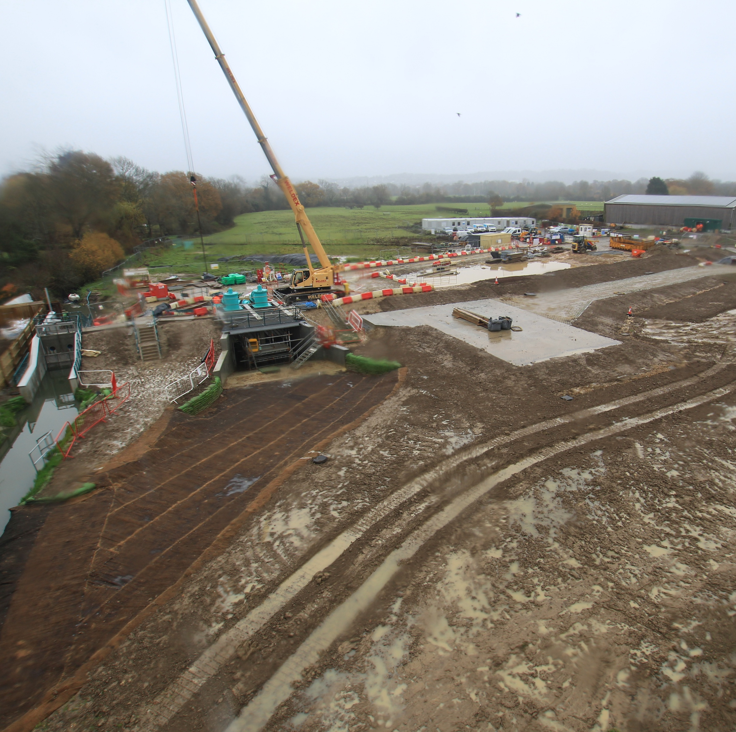
Quarterly Progress
Completed Structural Works​
Since our last drop in we have completed several Major milestones which include
Embankment construction, pump station concrete works,
Critical electrical infrastructure installation.​

Slide 4
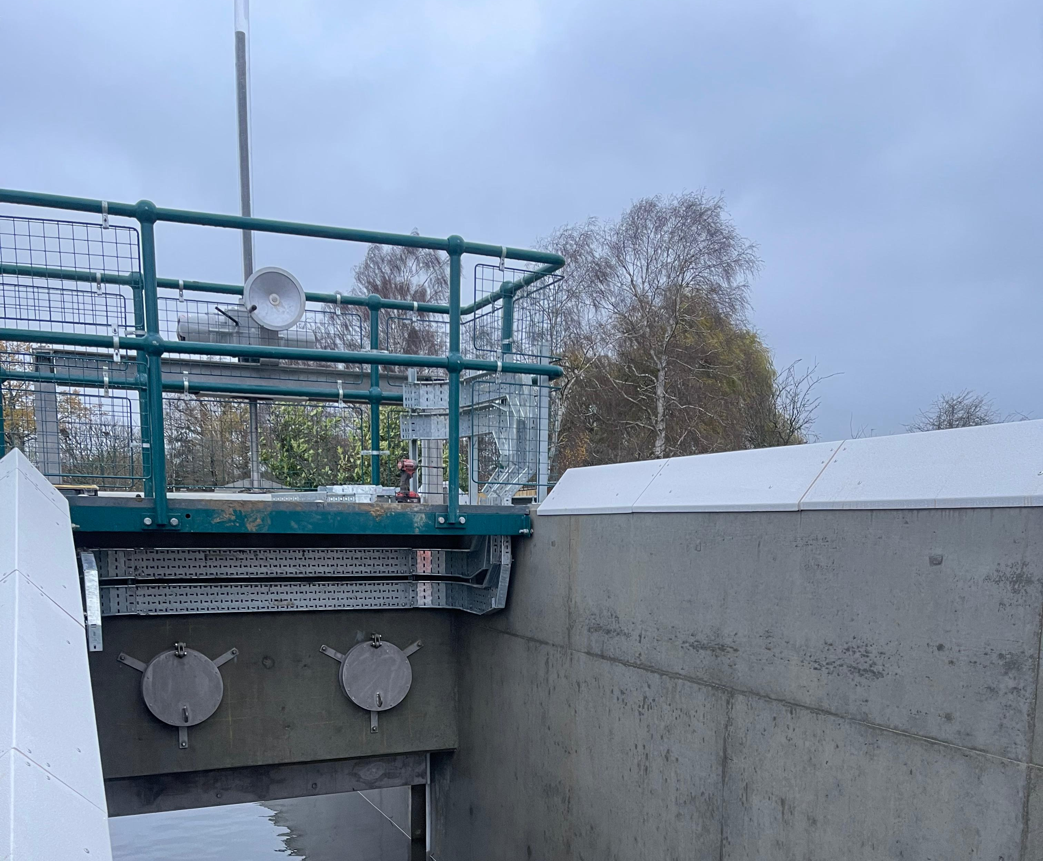
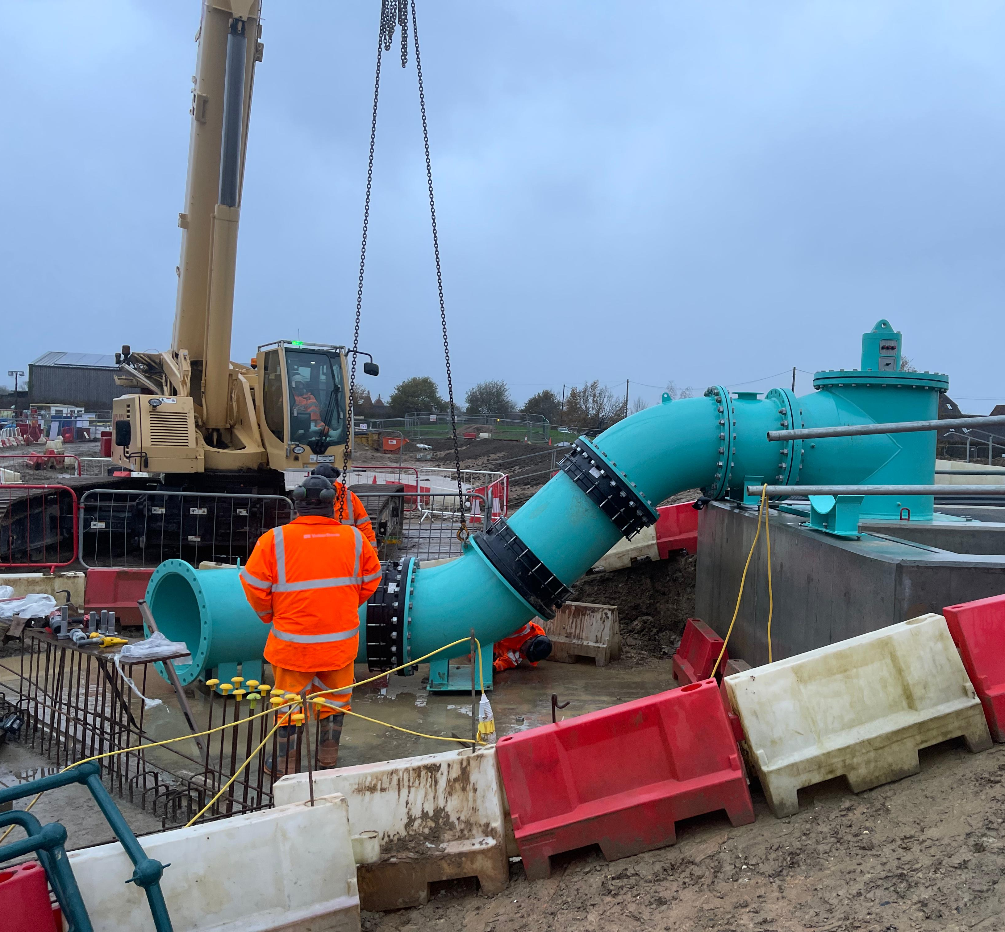
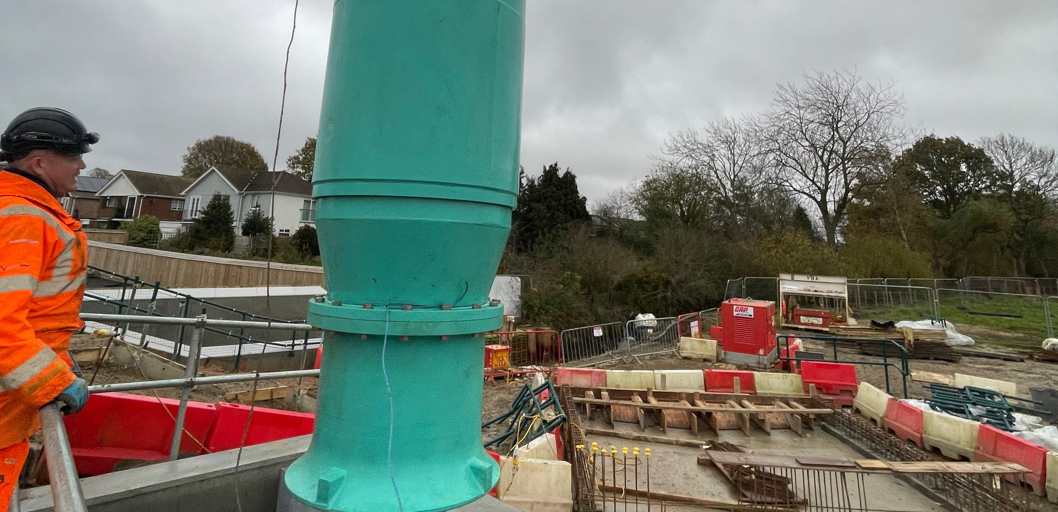
Penstock and Pump Station
All major concrete works for the penstock and pump station are now complete. This forms the structural base for the pumping system and associated infrastructure, marking a significant step toward operational readiness.

Slide 5
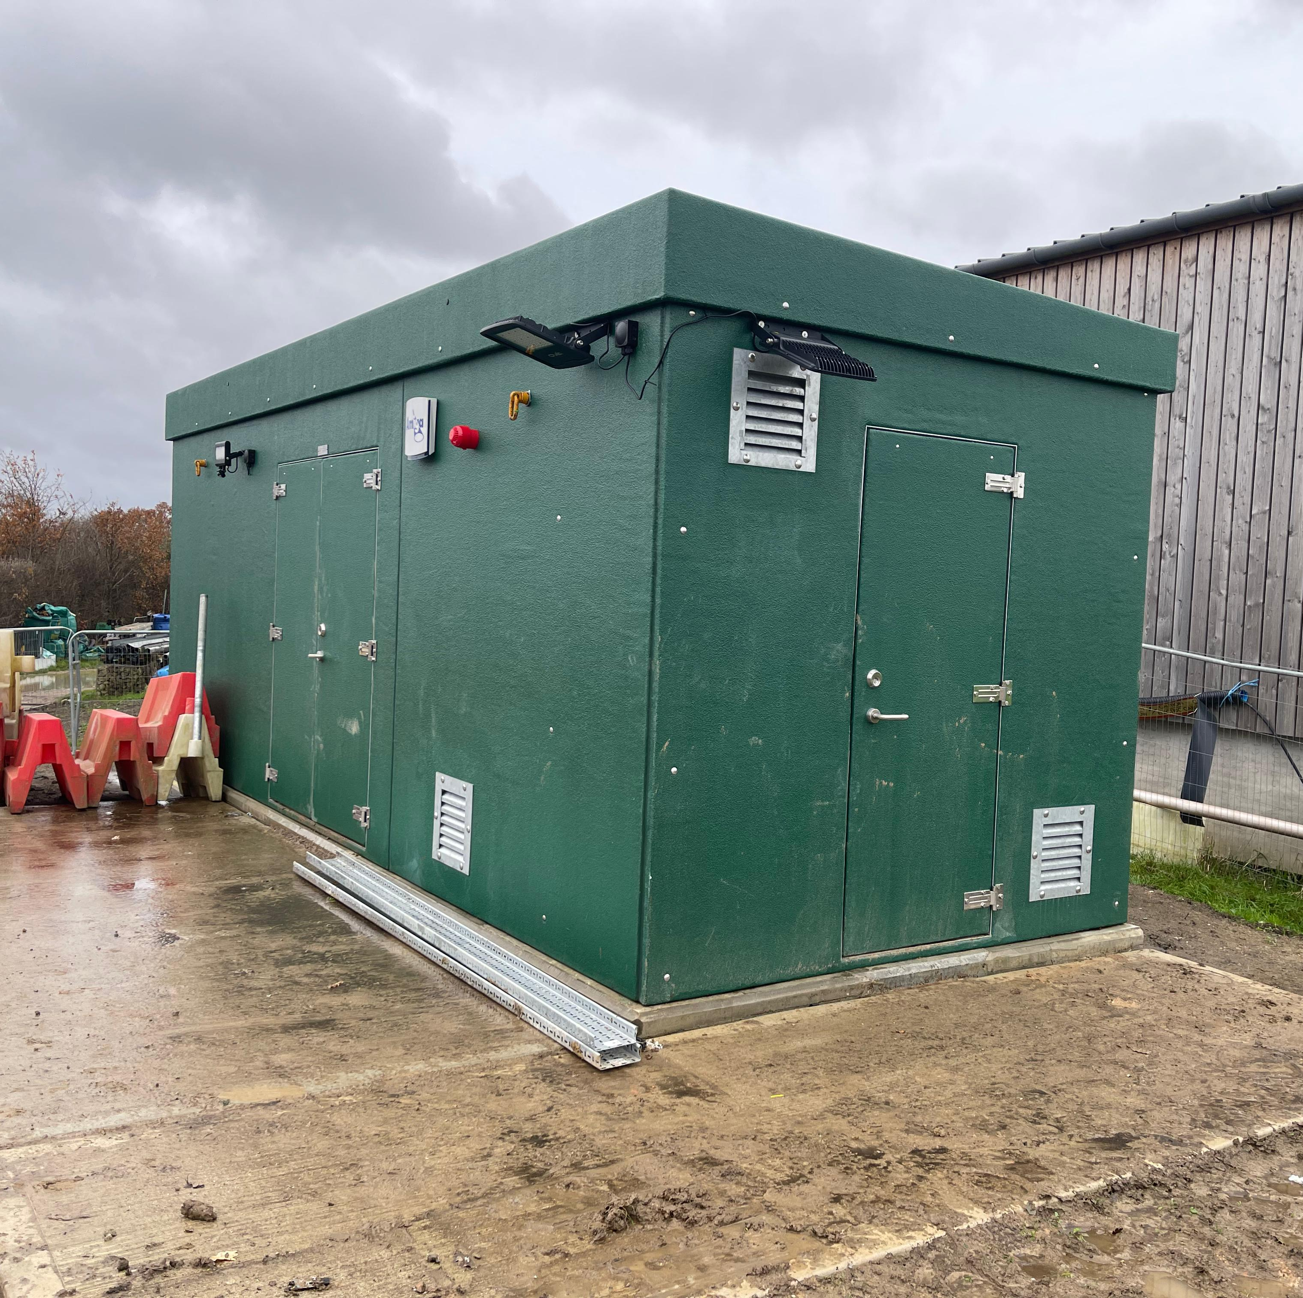
Electrical Kiosk
The new electrical kiosk has been installed and fully fitted out. It houses the control systems that will manage the pumps and site operations, ensuring efficient and reliable performance for the project.

Slide 6
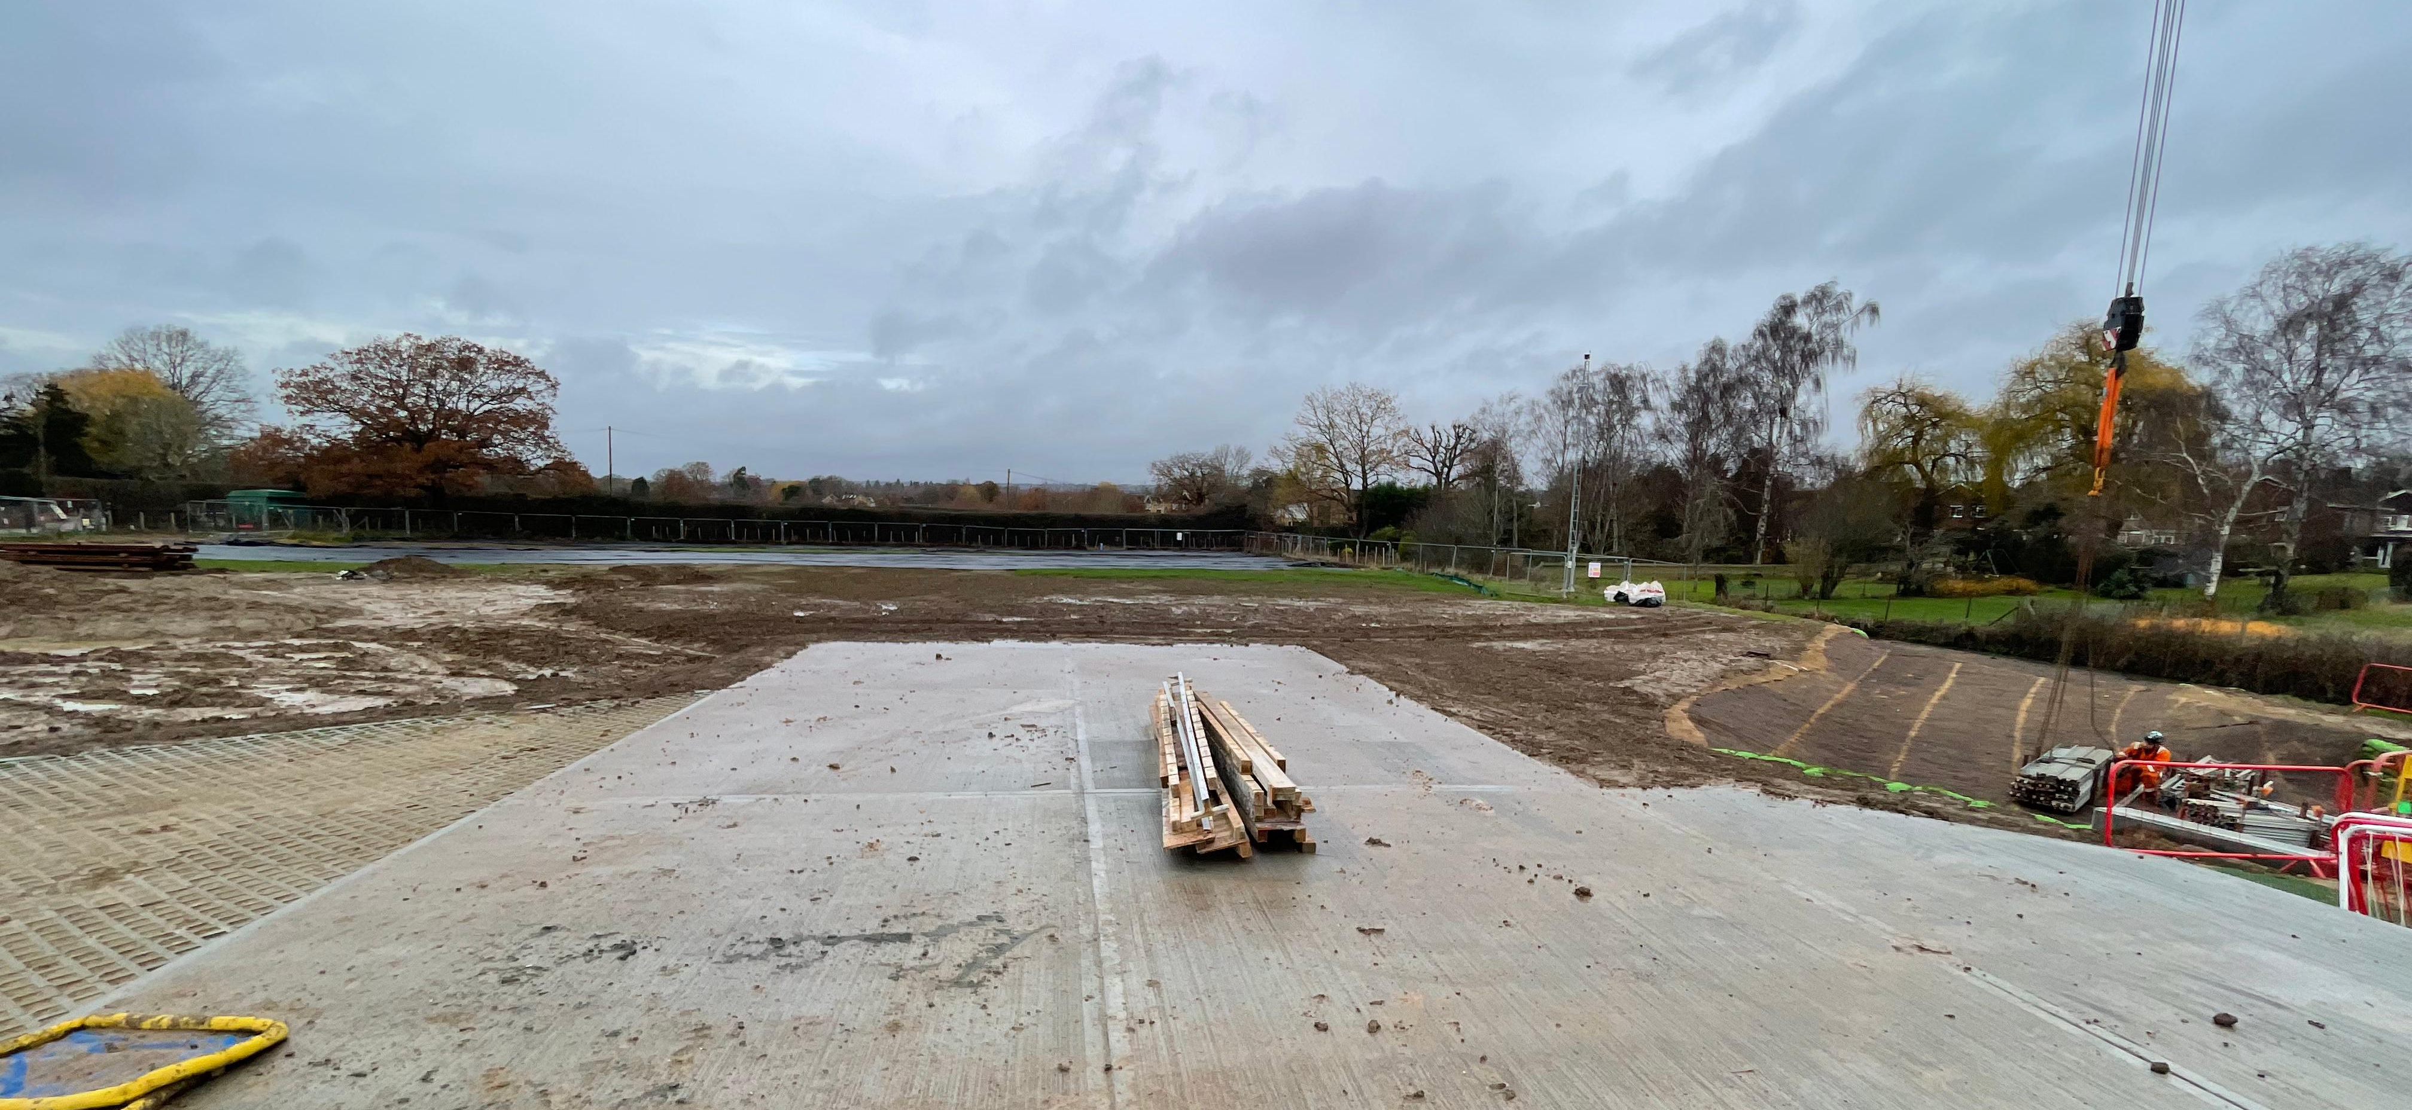
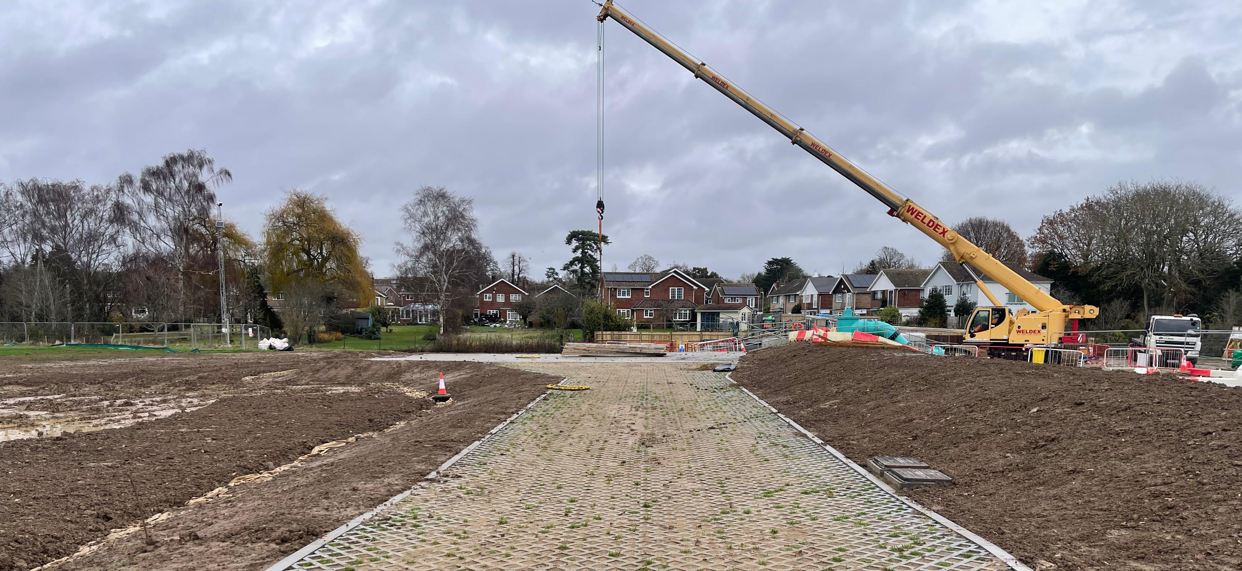
Crane and Maintenance Area
A dedicated crane and maintenance zone has been installed to enable safe lifting operations and provide easy access for future servicing of heavy equipment. This ensures long-term efficiency and safety for ongoing maintenance activities.

Slide 7
Whats Next
December
Installation of new pumps
New Year
Site Testing of Pumps
Continued work on the site infrastructure

Slide 8


Christmas Working Arrangements
Last working day: Friday, 19 December
Works resume: Monday, 5 January 2026
Our phones will be monitored during the Christmas and New Year break and we will reply as soon as we are able.
If you notice anything unusual or experience any problems during this period, please contact the VolkerStevin staff via Whats app
Your feedback helps us maintain safety and smooth operations.

Slide 9
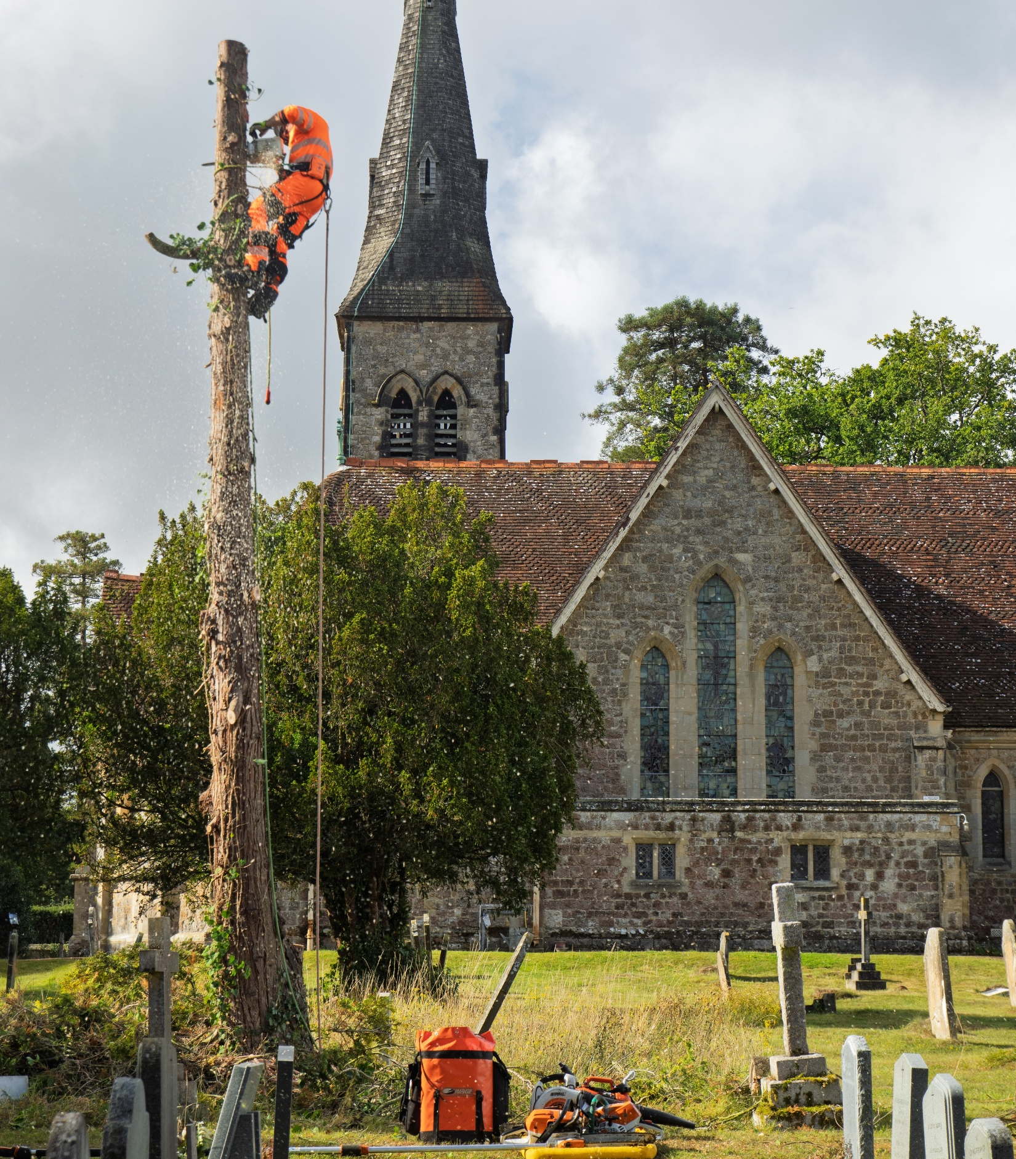
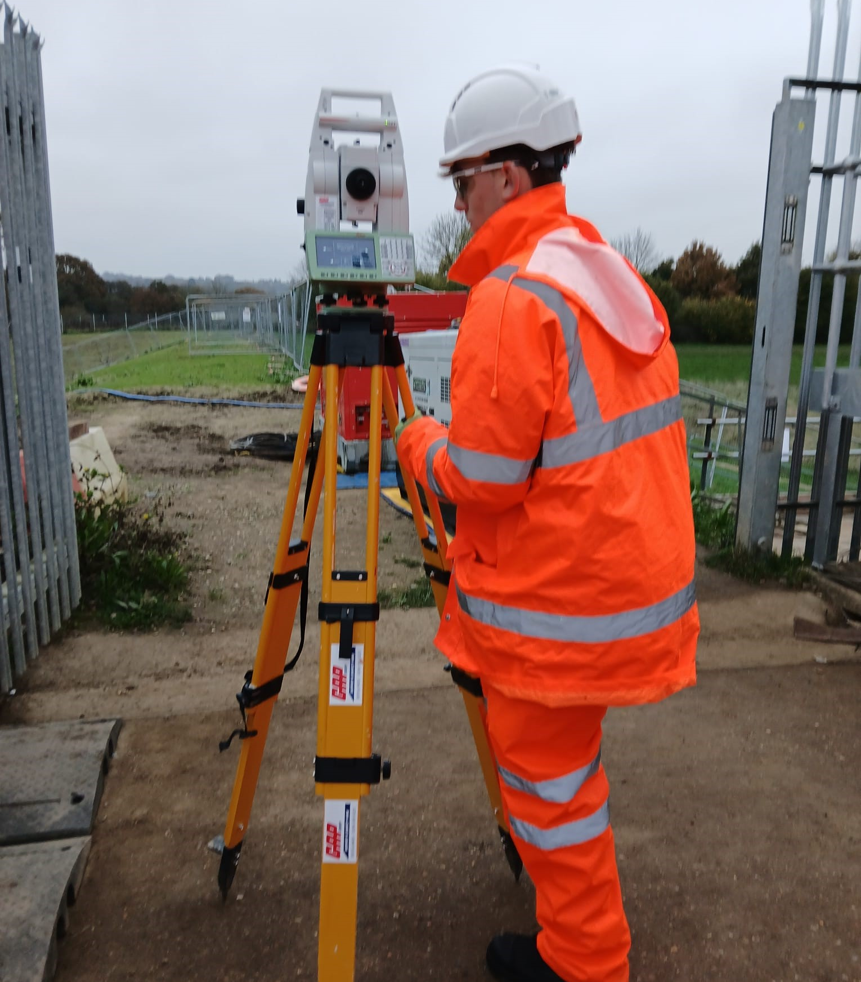
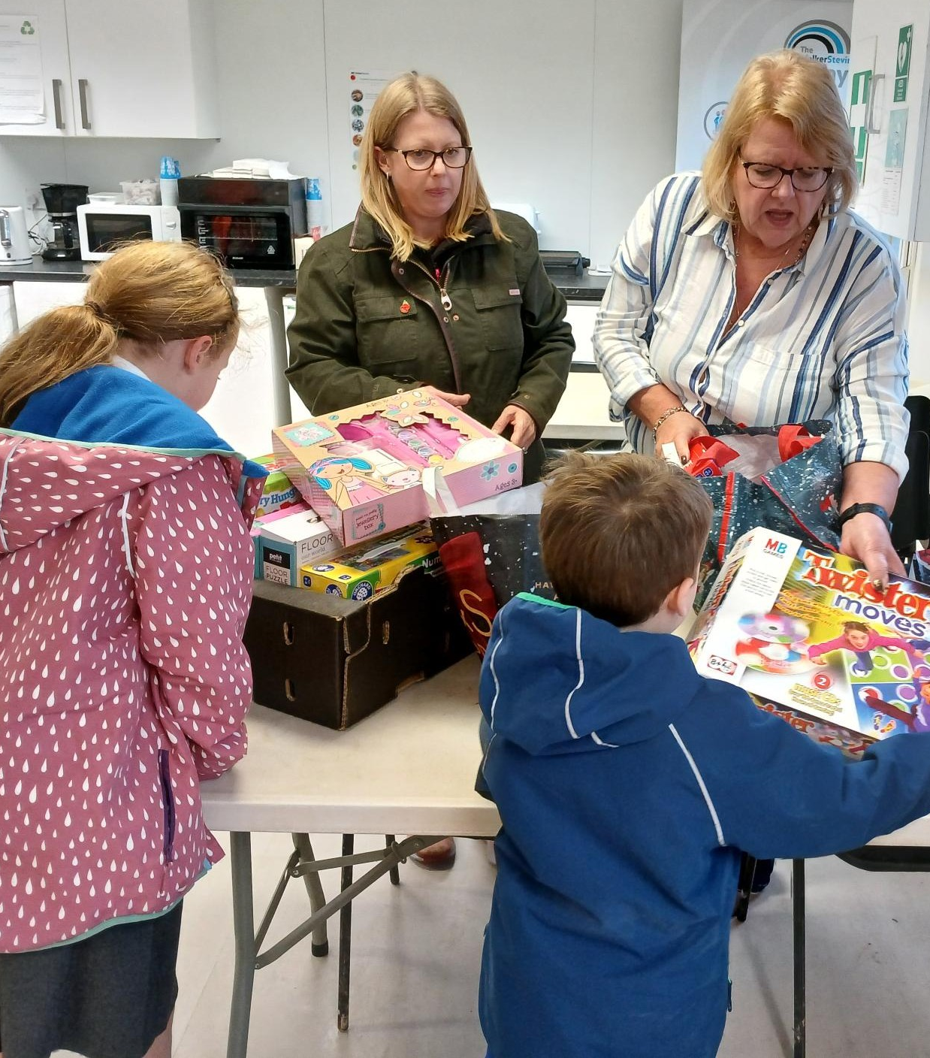
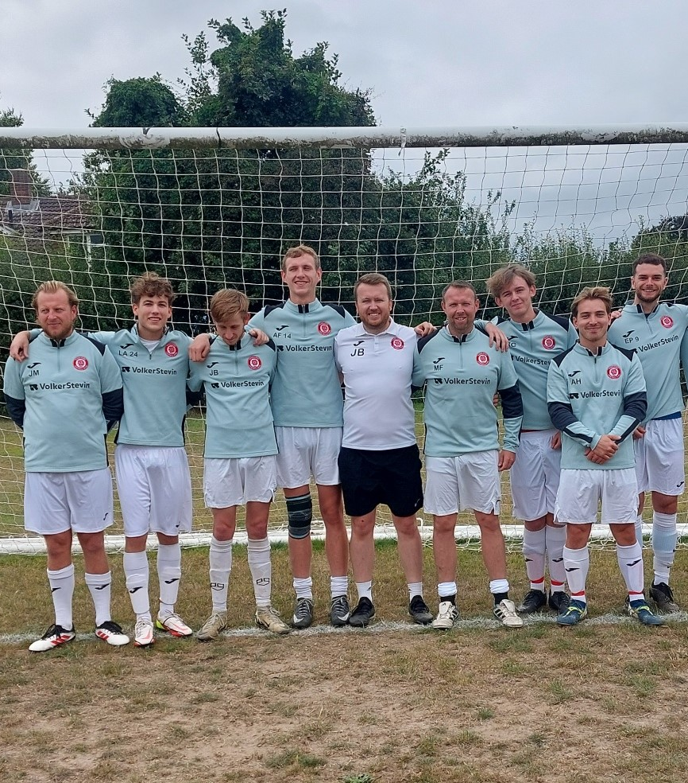
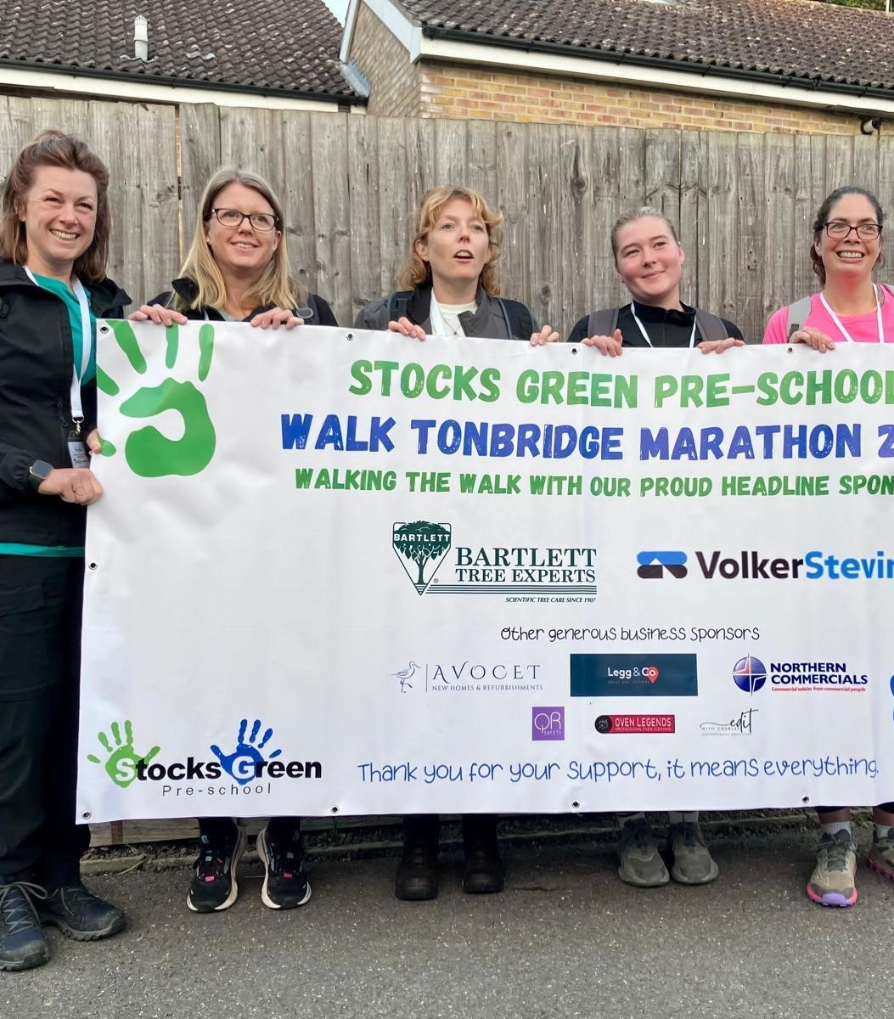
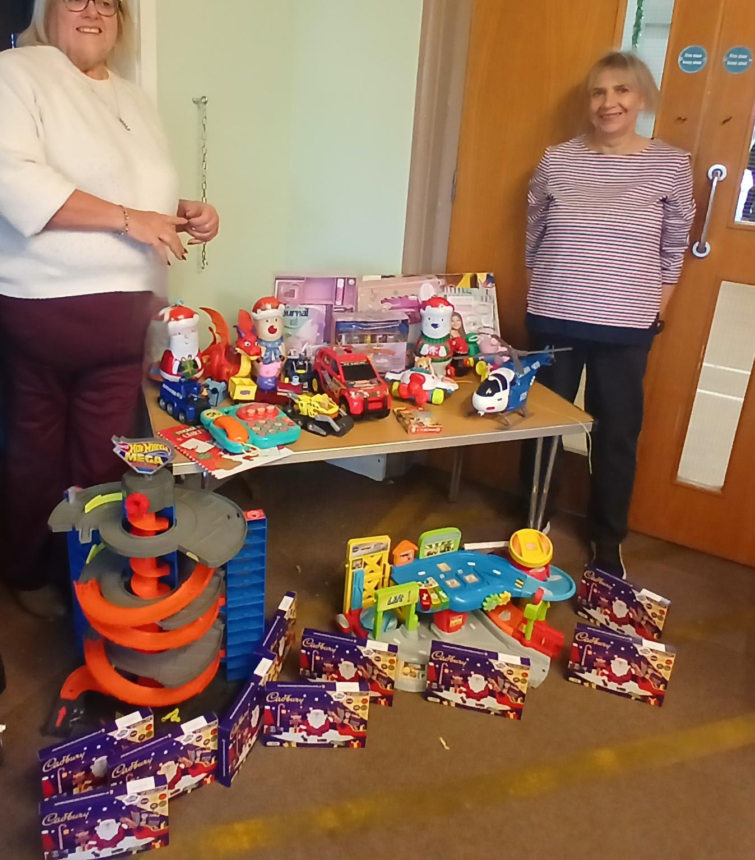
Thank You for your continued support
Not only have you been patient with us during our works, but locals have helped make a difference by supporting our Christmas Toy Drive. Together, we’re spreading festive cheer and giving back to the local community!
Here are a few snapshots of what we’ve been up to—from engaging local kids on work experience to community initiatives and much more. Taking down the tree in the church yard, supporting local children on site for work experience, sponsoring Roselands FC, and the Stocks Green Pre School, and numerous trips to support the local food bank – to name but a few !

