Slide 1
Regulation 18 Local Plan
Serving our community

Slide 2
Who am I and why am I here?
Matt Boughton
Leader, Tonbridge and Malling Borough Council
matt.boughton@tmbc.gov.uk
@MattBoughton93

Slide 3
What is a Local Plan?
The Local Plan guides decisions on future development proposals
Local Plans usually cover include housing, employment and shops. They also identify where development should take place and areas where development should be restricted.
The Local Plan must be consistent with the Government’s National Planning Policy Framework.
Local Plans are the main consideration in deciding planning applications.

Slide 4
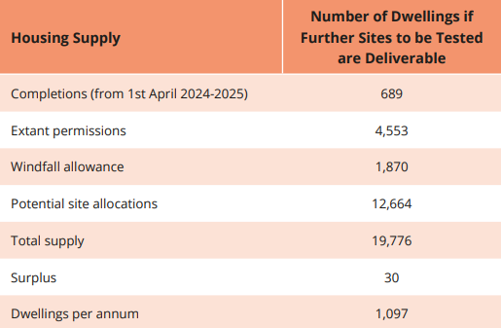
Why does Tonbridge & Malling need a Local Plan and what are we required to do?
There is a legal requirement to have a Local Plan
Development is coming forward ad-hoc and is developer led. This will continue until an adopted plan is in place and is likely to mean that the Council will have to spend money defending appeals and potentially also paying costs for the developers who bring those appeals.
The Government also mandates a housing figure – called Objectively Assessed Need – for each Council to deliver. These figures were updated in December 2024 and at present the Council’s overall need is 1,097 properties per annum.
If the borough don’t have a Plan, then it is at risk of Government intervention – this may ultimately result in powers being removed to determine where sites are allocated
Notes:
TMBC doesn’t have an adopted Local Plan or 5YHLS
Although the Council is allowed to account for permissions granted since April 2024 (start date for the plan) and also to make an allowance for Windfall (sites that may come forward outside of the Plan), there is still a need for XXX additional homes to be delivered over the life of the Plan, which is 18 years.

Slide 5
How do you decide what sites are allocated?
A 'Call for Sites' happens where the Council asks for land to come forward to form part of the Local Plan
Across the borough we have had over 600 potential sites come forward for review. These sites are then assessed against nationally set criteria to determine the most likely to be suitable e.g. ‘Grey belt’ criteria.
In the Draft Local Plan there are 95 residential or mixed-use proposed allocations
Brownfield sites in sustainable locations are prioritised – though there are not enough to meet the Government-set need
These sites are then presented for consultation. We are at this stage at the moment

Slide 6
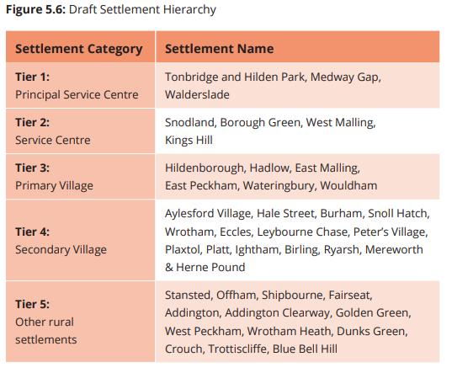
Settlement hierarchy
‘Most sustainable’ settlements are those where there are a greater range of services and facilities more easily accessible
The hierarchy does not determine on its own how much growth could take place in a settlement – this hierarchy is considered alongside environmental issues, physical constraints, land availability and other factors
Where there are Tier 1-4 settlements with no proposed sites, development could be proposed within the settlement confines, subject to other policies in the Plan
Tier 5 settlements could have development through the Rural Exception Sites policy or through a Neighbourhood Plan.

Slide 7
Where is housing development proposed?
Housing allocations for the purposes of the key diagram are split into 4 categories; anything over 250 units is detailed below. There are 39 allocations of fewer than 250 dwellings.
250-499 (5 allocations)
MG3 – Land at Bunyards, Beaver Road, Aylesford (435)
TO5 – South West Tonbridge (423)
EP2 – Church Lane, Hale Street, East Peckham (396)
TO2 – Coblands Nurseries, Trench Road, Tonbridge (294)
TO4 - Land west of Hilden Park, Hildenborough (289)
500-999 (3 allocations)
KH1 – Broadwater Farm, West Malling (900)
AY1 – Land at Aylesford Lakes (800)
HI2 – Land at Stocks Green Road, Hildenborough (629)
1,000+ (4 allocations)
BG1 – and North of Borough Green (2000 in plan period, 3000 overall)
TO1 – North East Tonbridge (1671)
SN1 – Holborough Lakes, Snodland (1300)
MG4 – Land East of Kiln Barn Road, Ditton (1300)

Slide 8
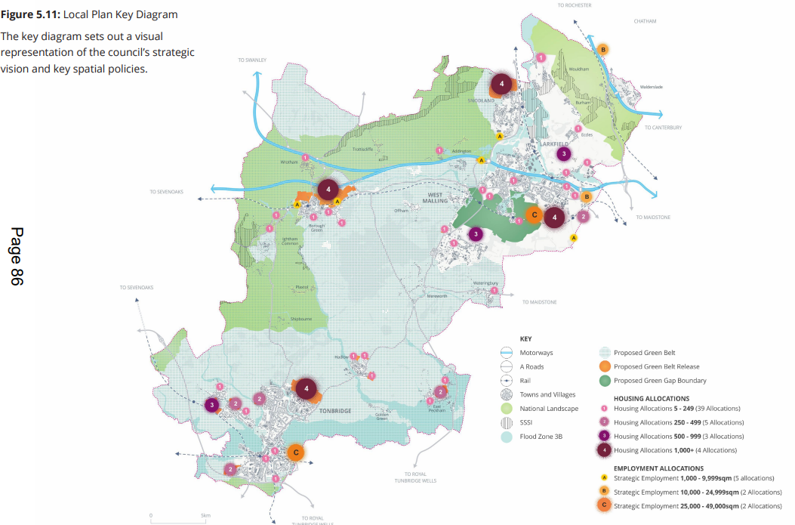

Slide 9
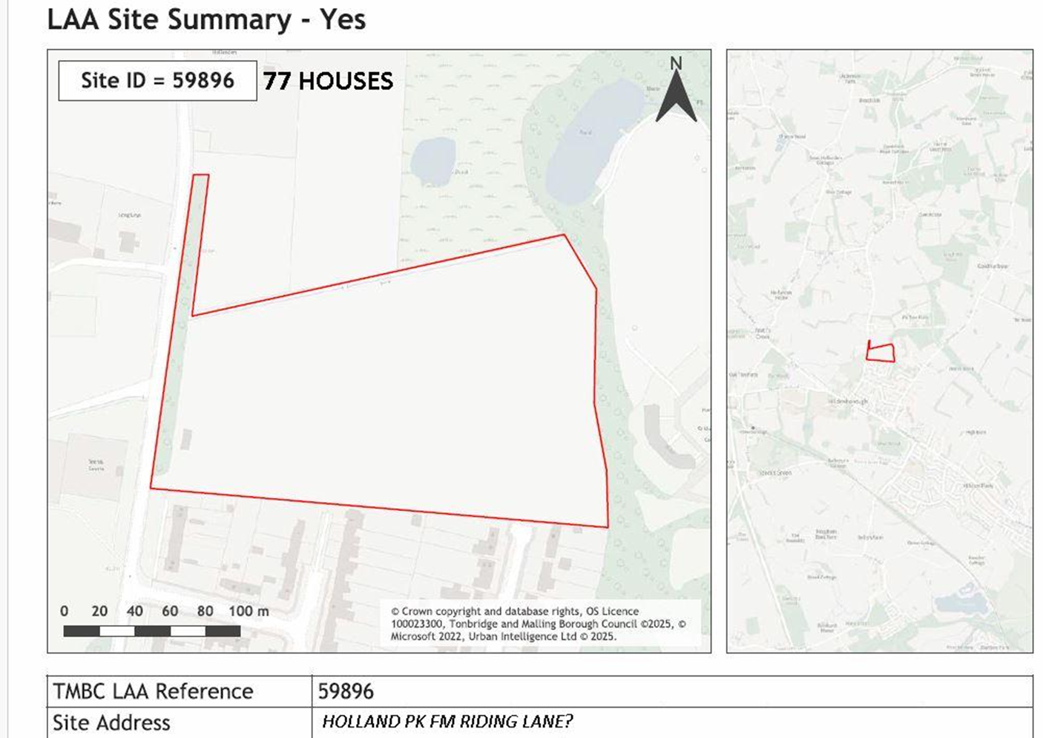
What sites are allocated near us?

Slide 10
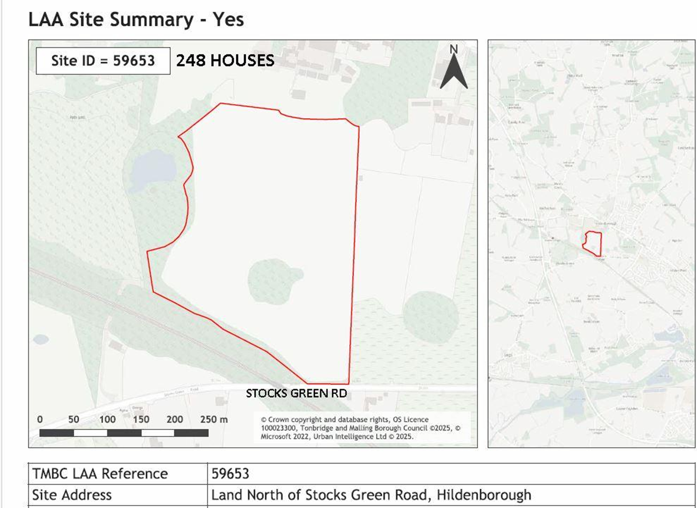
What sites are allocated near us?

Slide 11
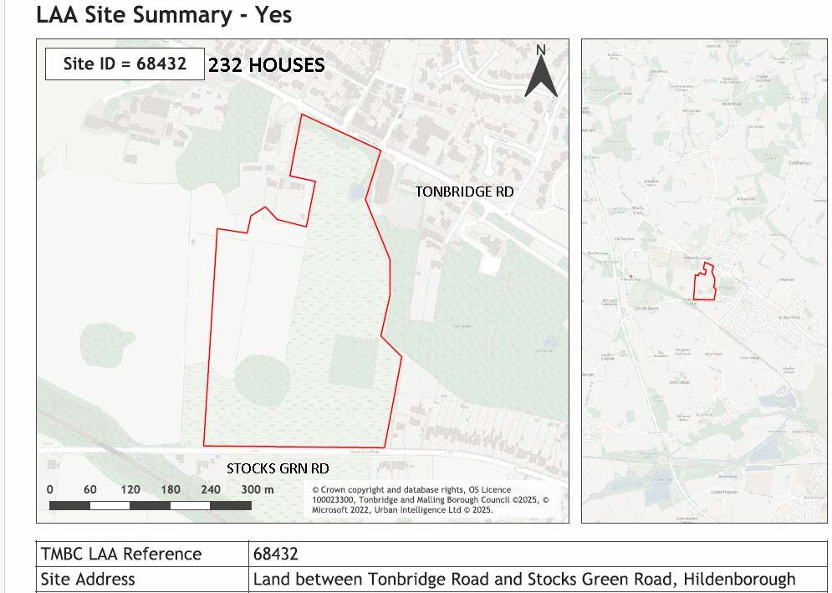
What sites are allocated near us?

Slide 12
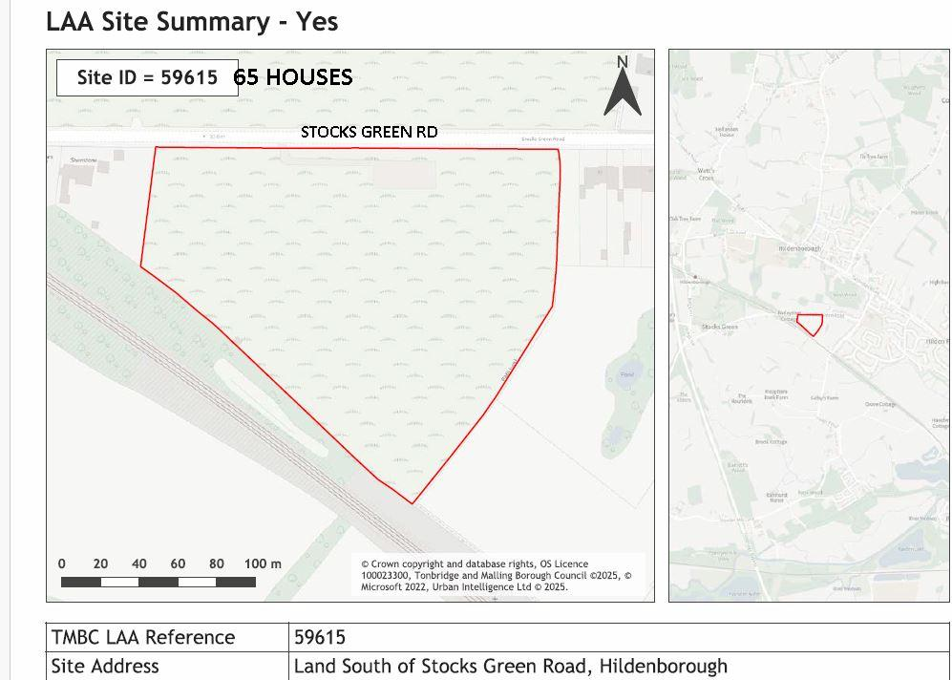
What sites are allocated near us?

Slide 13
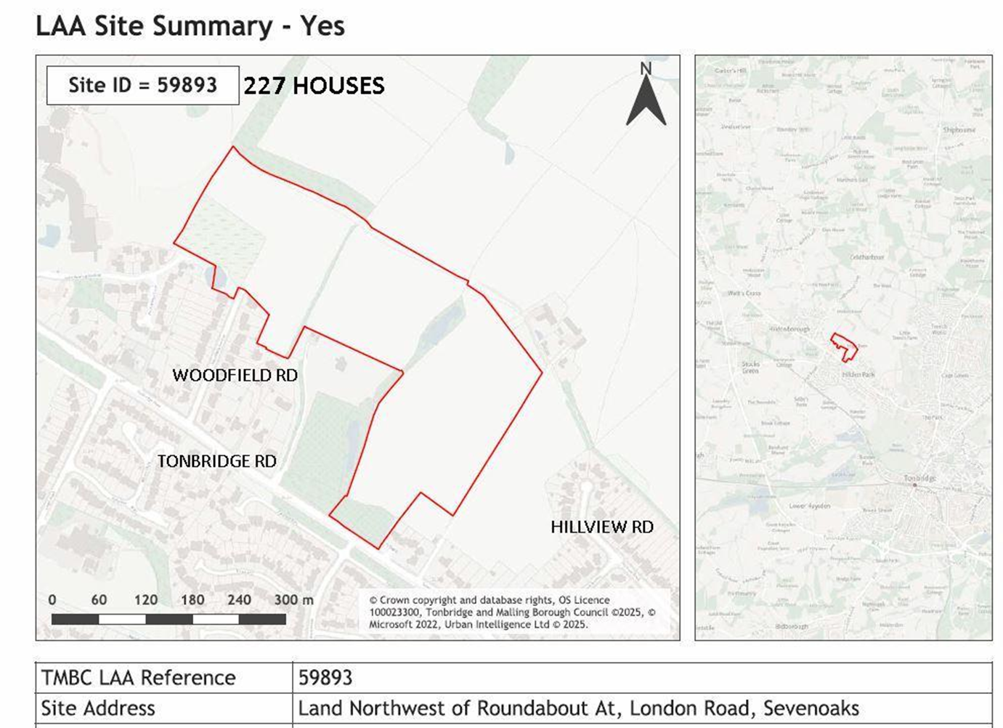
What sites are allocated near us?

Slide 14
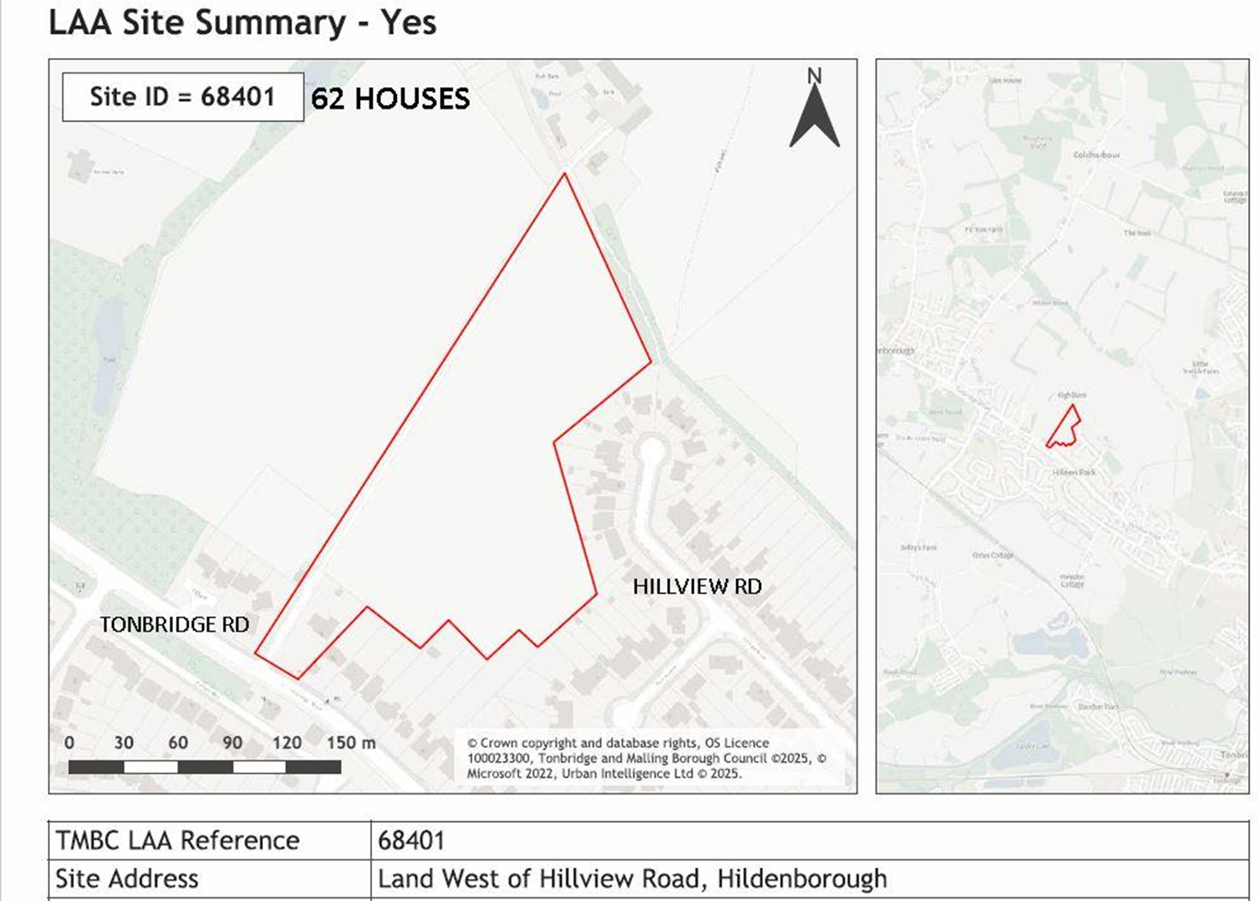
What sites are allocated near us?

Slide 15
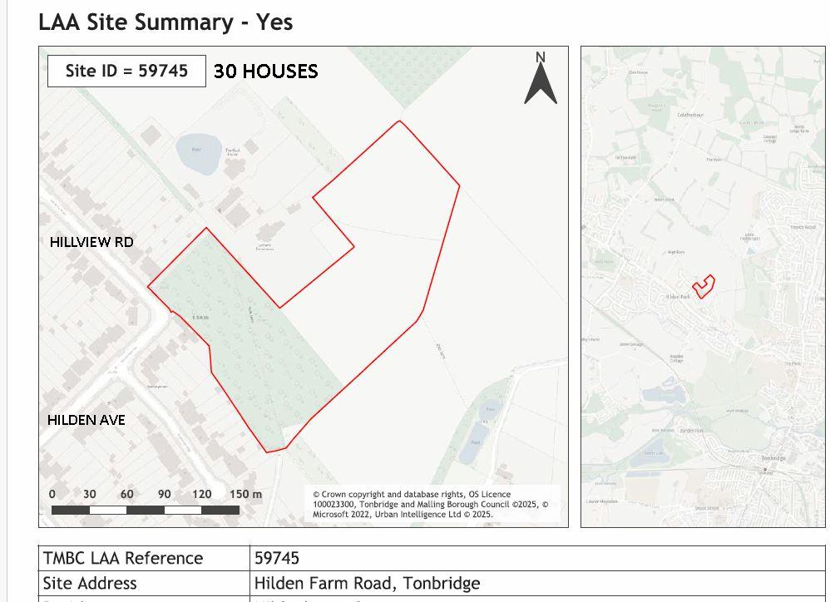
What sites are allocated near us?

Slide 16
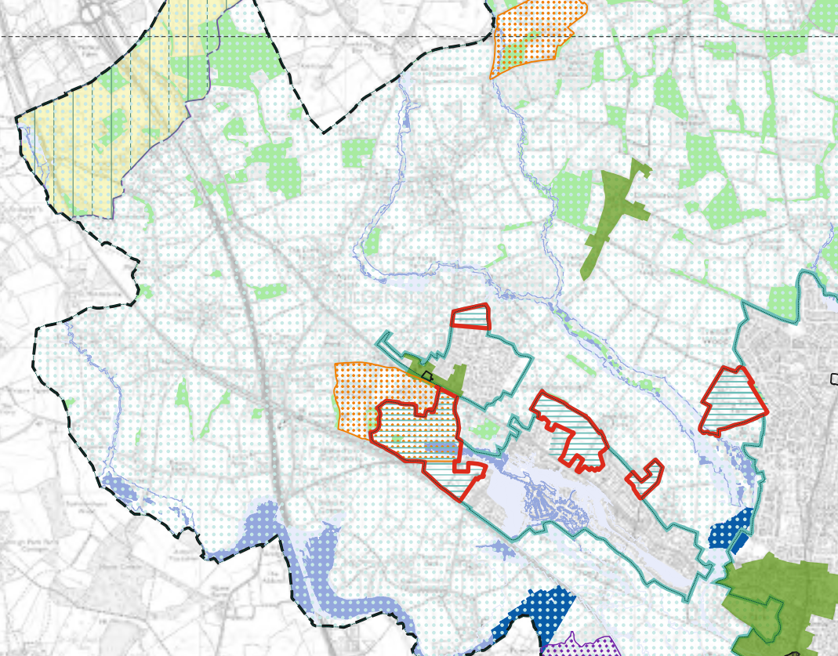
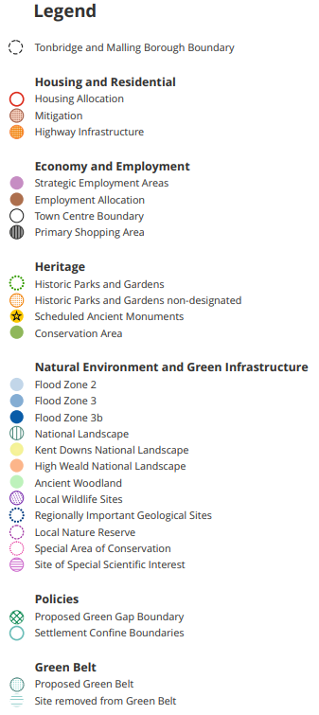

Slide 17
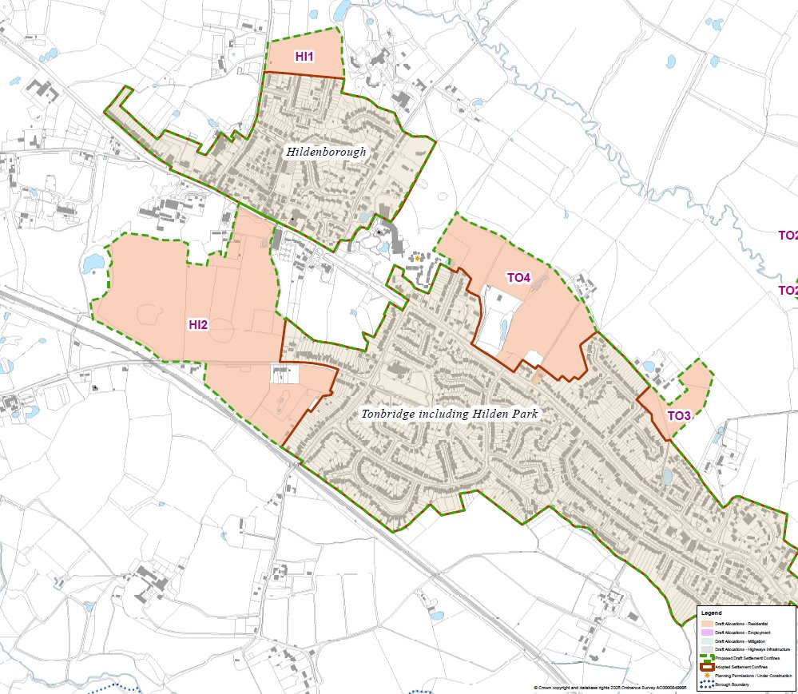

Slide 18
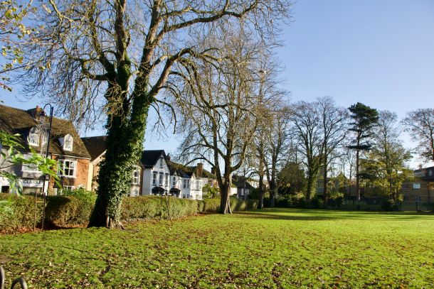
Who are the homes for and how will the Plan help local people find a home?
The Government’s housing figures take into consideration population growth from within and beyond the borough.
The Council already has a Local Lettings Plan Policy, which is applied to all new developments.
The Plan proposes that 40% of houses (increasing to 50% on Green Belt sites) should be ‘affordable’.
This percentage is then proposed to be split into 50% social rent, 30% affordable rent and 20% affordable ownership.

Slide 19
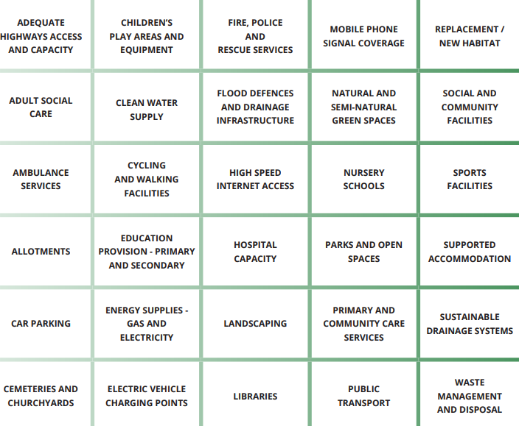
How can the Plan ensure services are delivered as well as houses?
Infrastructure Delivery Plan (IDP) is a key document – it looks at all existing and potentially required infrastructure and services.
The IDP looks at cost and delivery
This will look at what the Council can secure to fund infrastructure.
There may be site specific infrastructure, such as roads, that will need to be delivered at or before a certain point of development – these will be detailed in site specific policies that are developed for Regulation 19.

Slide 20
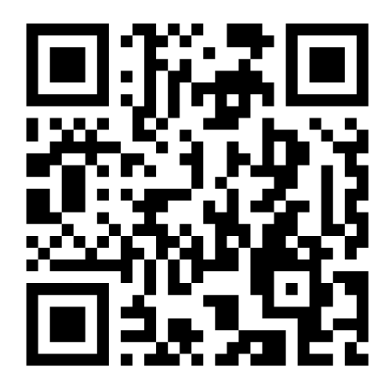
What is the point of the consultation and how do I make my views known?
The Council is legally required to consult on the Regulation 18 Plan
There is an opportunity between Regulation 18 and the Regulation 19 Plan to revise the proposals and the allocated sites – responding to the Regulation 18 consultation is the key opportunity to have your say.
The point of the consultation is to understand key Planning issues that may impact on sites –
Volume of negative responses are not something that will ‘move the needle’ on a Local Plan process, in the same way as in a planning application.
Some of those key issues to focus responses on might be highways, flooding, landscape, heritage
The Council is asking for as many responses as possible to be submitted via Commonplace

Slide 21
What will happen after the Regulation 18 consultation?
Reviewing all of the consultation responses – using technology to assist but this is still a huge exercise
Assessing any new sites that are submitted and obtaining the relevant evidence to understand their suitability
Updating our knowledge on proposed allocations where more information is available such as services, how the site will be delivered, viability and highways work.
Work to understand the deliverability of large strategic sites and when these could start.
Further testing could result in sites becoming unsuitable, reduce site capacity or site deliverability in the plan period i.e. reduce numbers overall or if new sites are submitted then it may mean that we do not need to release certain sites.
If a site is not included in the local plan, then we will need to defend that position with robust evidence at examination
If a site is included, we will need to demonstrate why it is a better site than other sites that we have excluded.
We can only achieve this through more testing and additional evidence being gathered

Slide 22
What is the timetable for the Local Plan?
10 November 2025 to 2 January 2026 – Regulation 18 consultation period
Summer 2026 – Council asked to approve Regulation 19 Plan for consultation, immediately followed by another consultation
By 12 December 2026 – submission of the Local Plan to the Planning Inspectorate (PINS)
Winter/Spring 2026/27 – Examination in Public of the Local Plan (this is subject to PINS scheduling)
By December 2027 – adoption of the Local Plan (this is subject to PINS scheduling)

Slide 23

Questions?

